Slide 1
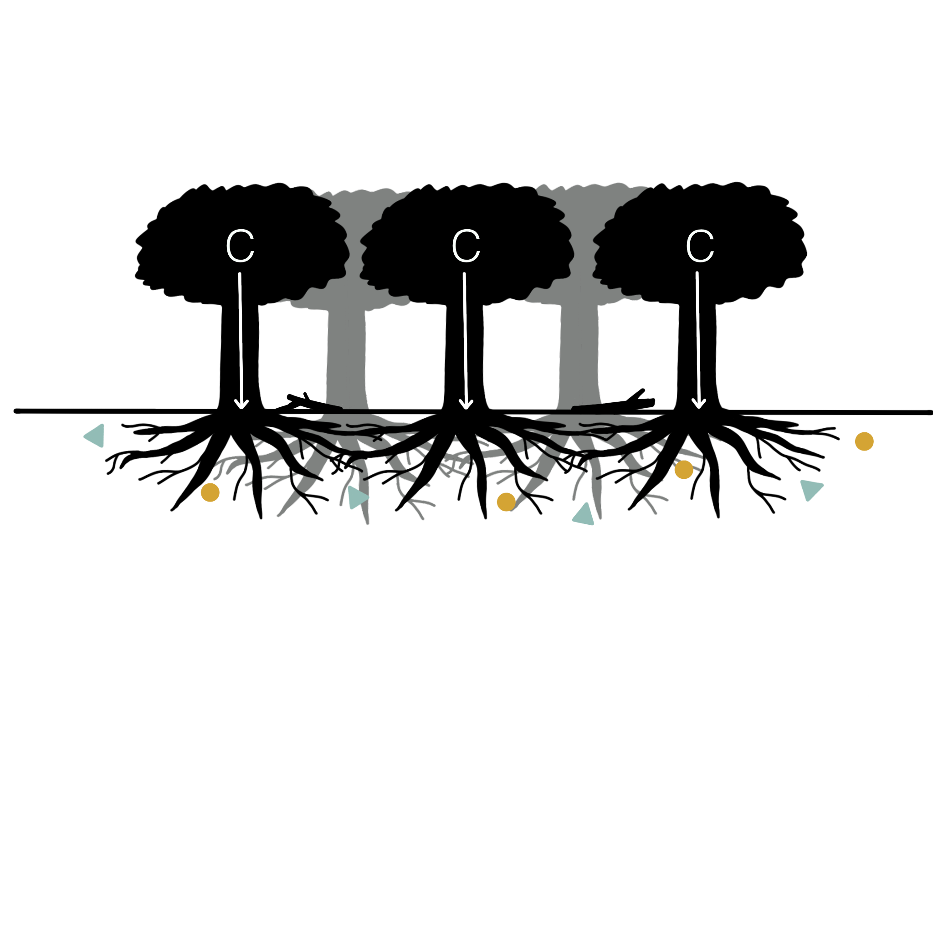
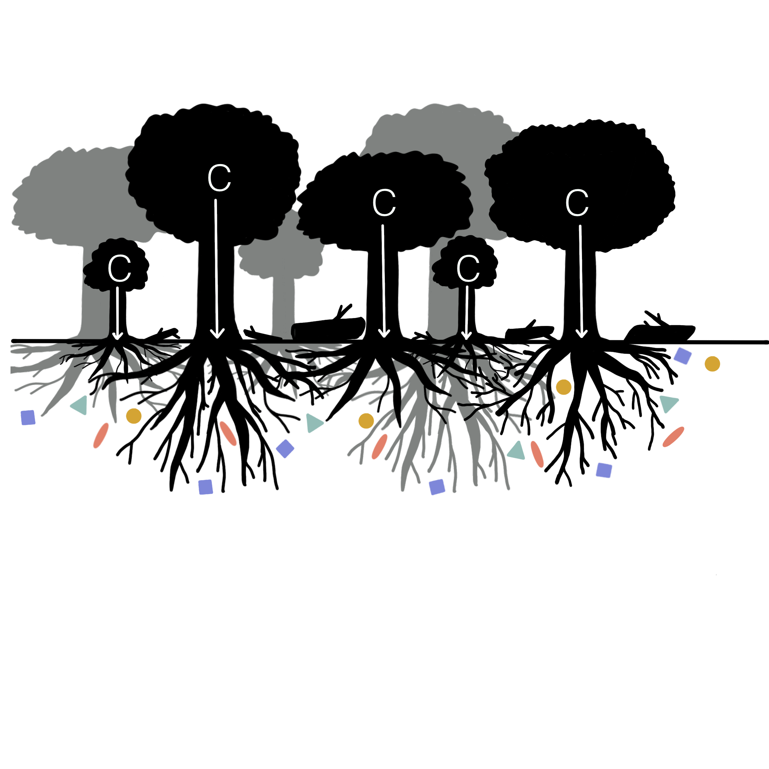
Figure 1. Forest structural diversity may influence soil microbial diversity through several pathways. A less structurally diverse forest (A) may support lower soil microbial diversity due to lower productivity and belowground carbon allocation, less coarse woody debris, and less complex rooting architecture relative to that of a more structurally diverse stand (B). Shapes indicate different microbial taxa.

